Slide 1

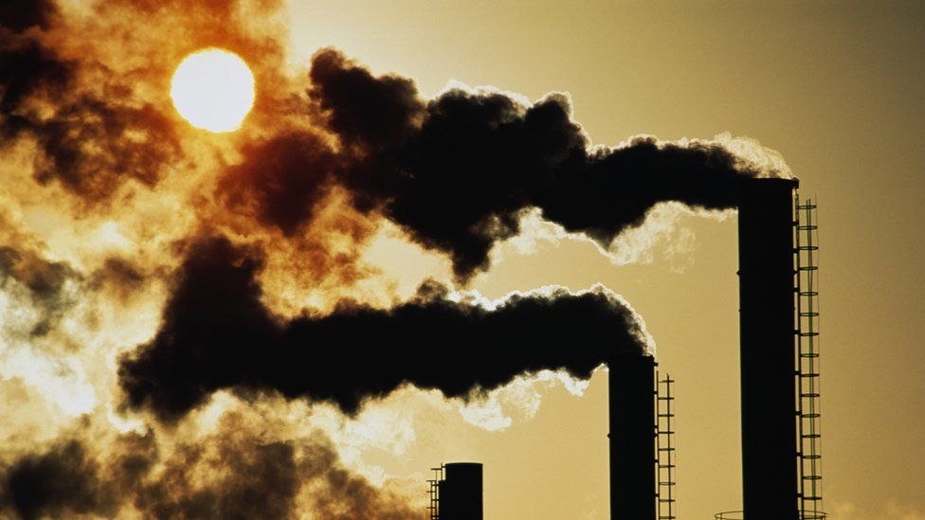

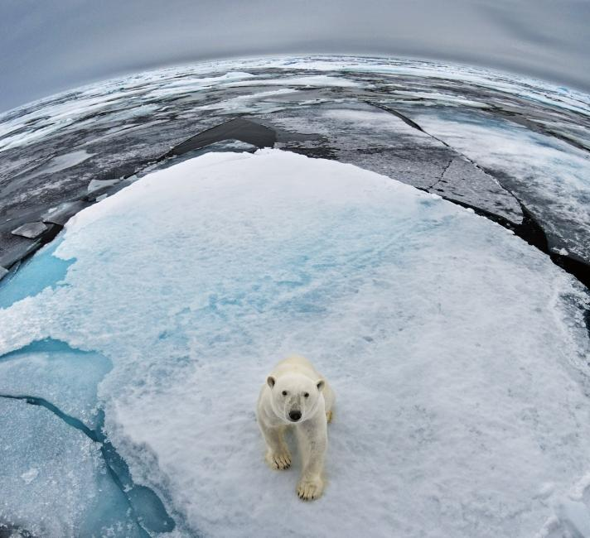
MOHAMMED ARIF-20W91A1226-MOHAMMED ARIF-20W91A1226-MOHAMMED ARIF-2
MOHAMMED ARIF -20W91A1226- MOHAMMED ARIF- 20W91A1226-MOHAMMED ARIF-20W91A1226 -MOHAMMED ARIF-MOHAMMED ARIF- 20W91A1226
MOHAMMED ARIF-20W91A1226-MOHAMMED ARIF-20W91A1226-MOHAMMED ARIF-2
Is all the fuss actually anticlimactic or just dramatic?
The ever-convenient air conditioners on our walls cools up our rooms for a brief time but in turn harms and warms the earth.
“The next step for change is just around the corner”
-Simon Stiell, UN climate Change Executive Secretary at COP27.
6 yrs 238 d and counting
MOHAMMED ARIF- 20W91A1226- MOHAMMED ARIF-20W91A1226- MOHAMMED ARIF-20W91A1226- MOHAMMED ARIF-MOHAMMED ARIF -20W91A1226

